Slide 1





Attitudes Towards Mental Health in the Tech Workplace
Notes:
Hey guys! My group decided to do our project on

Slide 2

Data Science Society GM Project
By Aashritha Srirambhatla,
Aditi Raja, Prachi Deo, & Tanvee Joshi

Slide 3
Some days, the best thing about the job is the chair spins.”
-Unknown
Notes:
So let me start off with a question for you all: thumbs up on zoom if you’ve ever felt stress about working in the tech field
Well u r not alone, an unnamed worker in the tech industry said X

Slide 4
Our Question:
What are the strongest predictors of certain attitudes towards mental health in the tech workplace?
Notes:
Thinking about the quote got us thinking about how we would predict this and what factors allow us to predict it… so we came up with this question
We were thinking of using DS to solve this because data science is always a great tool to solve problems. Next we will go thru our procedure.

Slide 5



1.Understanding the Data
Tables &
Visualizations

Slide 6
Reading our Data
import pandas as pd
read_file = pd.read_csv('mental-health-in-tech-2016_20161114.csv')
Then we sorted the data and dropped columns that were not necessary
Notes:
Sorting data is really important in DS because it allows us to best visualize our data, since we are focused on this particular thing…

Slide 7








Matplotlyb.pyplot to visualize our table

Slide 8
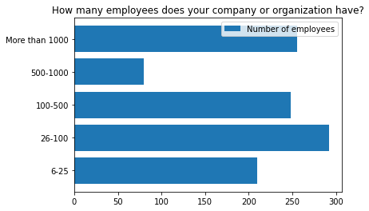
Question:
How many employees does your company/ organization have?
-bar graph was our visualization of choice
Notes:
Explain what graph shows and why we chose bar

Slide 9
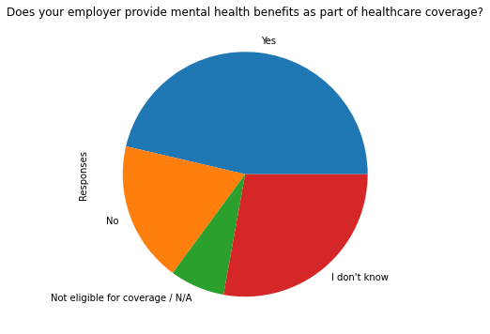
Question: Does your employer provide mental health benefits as part of healthcare coverage?
-a pie chart was our visualization of choice
Notes:
Explain what graph shows and why we chose bar

Slide 10
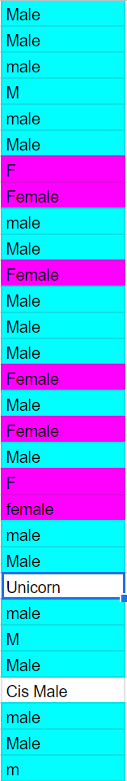
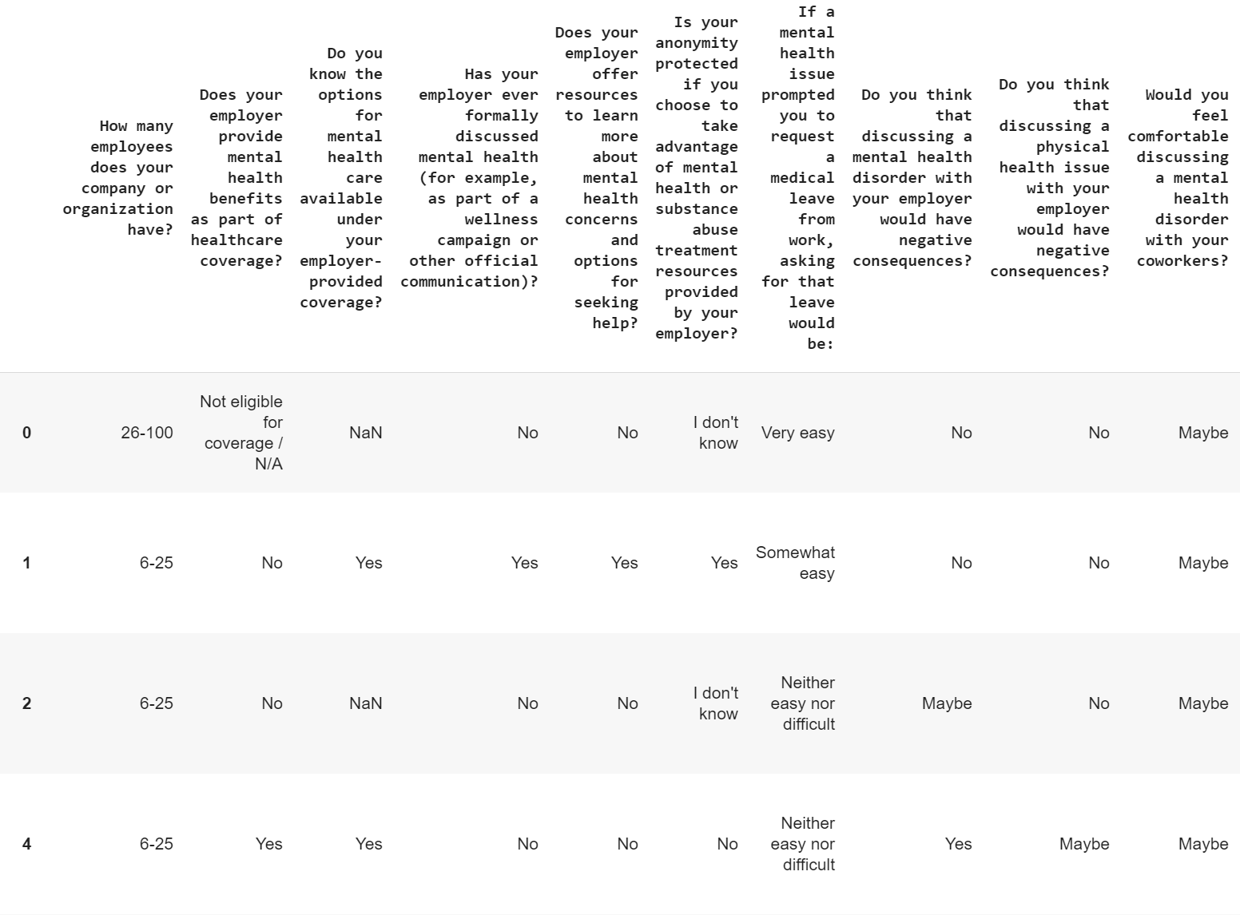
Difficulties
Data from free response survey
Yes or No → 0 or 1
Female/F/female/f → Female
Male/M/male/m → Male
‘6-25', '26-100', '100-500'
→ Small
'500-1000', 'More than 1000'
→ Large

Slide 11
2. A/B Testing
Our method of Statistical Inference

Slide 12
Initial Testing...
Null Hypothesis: Providing mental health benefits does not impact comfort in discussing mental health with a supervisor
Alternative Hypothesis: Providing mental health benefits makes employees more comfortable with discussing mental health with a supervisor
Test Statistic: Difference between the proportion of people who are comfortable talking about their mental health issues among those who get mental health benefits and proportion of people comfortable talking about mental health issues who do not get those benefits.

Slide 13
Null Hypothesis: The size of the company does not have an effect on whether employees are comfortable discussing mental health issues in a small or large company.
Alternative Hypothesis: People are more likely to be comfortable discussing mental health issues with a supervisor in a small company than in a bigger company.
Test Statistic: One-sided - Difference between the average of proportions of people who are comfortable talking about their mental health issues in a small company and the average of proportions of people who think the same way at a large company.

Slide 14
Observed test statistic: 0.0867736
P-Value: 0.015

Slide 15
P-Value:
The p-value is low, which means the alternative hypothesis is favored. People are more comfortable discussing mental health issues at a smaller company than a larger one.

Slide 16
Null Hypothesis: Gender does not have an impact in discussing mental health with a supervisor.
Alternative Hypothesis: Gender does have an impact in discussing mental health with a supervisor.
Test Statistic: Two-sided: Absolute difference between the average of the distribution of people who are comfortable talking about their mental health issues among females and the mean of the distribution of people comfortable talking about mental health issues among males.
Notes:
we thought gender would have an effect

Slide 17
Observed test statistic: 0.0076556
P-Value: 0.935

Slide 18
P-Value:
The p-value is high, which means the null hypothesis is favored. Gender does not have a significant impact when discussing mental health with a supervisor.

Slide 19
Conclusions

Slide 20
Gender was not a statistically significant determinant of mental health attitudes. However, the size of companies was statistically significant.
Notes:
& explain relevance to our question
gender not a predictor of certain attitudes toward mental health in tech workplace
size of company is a predictor

Slide 21
Implications for the Future
Notes:
Good for females going into tech and big companies should keep in mind that they should try to build a community within the big one to allow everyone to understand that mental health resources are easily accessible

Slide 22

Thanks!
Any questions?

